Slide 1
Criminal Trial Preparation

Slide 2
A Prosecutor The Primary Compensation is not Money
Notes:
The Jerry May Trial
1984, 34 year old prosecutor
High profile trial
Defendant a major power broker
Middle man – morning governor, mayor, congressman, judges, evening- Tony Spilotro and Frank Rosenthal
Jury Foreman- guilty guilty – proved that the mob connection could be exposed
Satisfaction – It brought me no extra money and no fane but it did bring me lasting satisfaction

Slide 3
General Principle
In America, when there is a criminal matter, the legal system’s mission is to preserve social order by determining the true facts and circumstances concerning an event without bias and prejudice so that a just result can be obtain. The police, the prosecutor, Judge and Jury each perform separate functions in the process.
The role of the Police
The role of Prosecutor
The role of the Judge
The role of the Jury
Unlike most countries, in the American legal system the prosecutor plays the most central role. In Europe and Asia, the Judge plays a far greater role in resolving matters. They are the investigator with assistance of the police, prosecutor and defence attorney, as well as the determiner of the law and facts and sentence.
American Prosecutors are the GUARDIANS of TRUTH and JUSTICE.

Slide 4
SEARCH FOR TRUTH OR SEARCH FOR FACTS UNDER LAW OR ?
Unsettling Truth
Notes:
ABA Insights Publication - November 08, 2018 Article 1 - Justice wasn’t blind at all: black people faced greater police brutality and got longer sentences, more attractive witnesses were more likely to be believed, overweight female defendants were judged more harshly. Jurors and detectives, tasked with determining credibility, were actually quite poor at detecting deceit and tended to focus on irrelevant cues like averted gaze and jittery limbs. There was no such thing as an unbiased judge: every member of the bench was looking through lenses tinted by their identities and experiences. And factors meant to be irrelevant frequently tipped the scales. People whose parole hearings were first thing in the morning were far more likely to be granted release than those who had the bad luck of being scheduled at the end of the day. Watching footage of an interrogation with the camera placed behind the suspect meant that you were significantly more likely to deem a resulting confession to be coerced than if you viewed footage shot from behind the interrogator.

Slide 5
Lessons Learned My First Trial
1. Material witnesses have limited choices
2. Eye witnesses are not to be trusted
3. Witnesses should stay away from Jurors
4. You should assume witnesses are going to lie so be prepared
5. Never under-estimate the opposing attorney

Slide 8
Elements of Criminal Trial
1) Jury Selection
2) Opening Statements
3) Presentation of the Prosecution Case
4) Presentation of the Defense Case
5) Closing ARGUMENT
6) Jury Instructions
7) Jury Deliberation
8) Verdict on Guilt
9) (if Defendant found guilty) Sentencing Phase
10) Judgment and Sentence

Slide 9
Criminal Trial War Real Life Drama

Slide 12
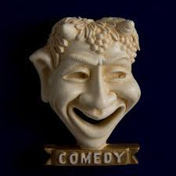
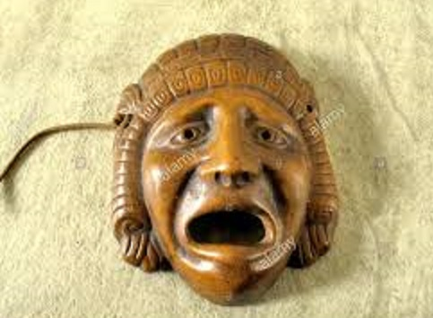
Drama
Notes:
Tony Spilotro trial - 1986
The whole experience was made for movies- in fact it became a Movie

Slide 13
Elements of a Drama – according to Theatre Arts Course Outline
Coming up with Thought/Theme/Ideas to be expressed through the work.
Determine the Genre and Style of the work
Outlining Basic Action of the work and Creating Plot.
Establish the Structure of the Play and Overall Framework
e) The Development of Characters presented in the work.
The Creation of Dialogue and the Language of the Characters.
Creating Music: This can involve the Rhythm of the Language or actual Music
Composition and the Lyrics of the songs.
Establishing Spectacle: The visual and Environmental elements of the work.
i) Research of Subject Matter and Relevant issues presented in the play.

Slide 14
Elements of a Drama/Trial
Coming up with Thought/Theme/Ideas to be expressed through the work.
Determine the Genre and Style of the work
Outlining Basic Action of the work and Creating Plot.
Theory of the case
Types of Evidence
Outline of Presentation of Evidence

Slide 15
Elements of a Drama/Trial
Establish the Structure of the Play and Overall Framework
e) The Development of Characters presented in the work.
Prepare the Closing Argument and evidence to support points in Closing.
e) Prepare Witnesses to prove elements of the crimes – use checklist

Slide 16
Elements of a Drama/Trial
The Creation of Dialogue and the Language of the Characters.
Creating Music: This can involve the Rhythm of the Language or actual Music Composition and the Lyrics of the songs.
Outline of each witness testimony
Audio visual evidence, demonstrative evidence

Slide 17
Elements of a Drama/Trial
Establishing Spectacle: The visual and Environmental elements of the work.
i) Research of Subject Matter and Relevant issues presented in the play.
h) Your demeaner and conduct – the majesty of the Court room –respect of Justice
i) Preparation of the Jury Instructions and presentation of evidence in conformity

Slide 18
Elements of Trial Preparation
Determine the Theory of the case
Determine Types of Evidence to be presented
Prepare an Outline of the Presentation of Evidence
d) Prepare the Closing Argument and the Evidence to support it.
e) Prepare the witness testimony to prove the elements of the crimes- have a checklist of elements
Prepare an outline of each witness’ testimony
Prepare audio visual evidence, demonstrative evidence before trial
h) Control your demeaner and conduct to enhance the majesty of the Courtroom, do justice and gain the respect of the Judge and Jury.
i) Present the evidence to conform to the Jury Instructions and your Closing Argument

Slide 19
Criminal Trials Only 1.03% of Criminal cases go to trial WHY ARE YOU GOING TO TRIAL?

Slide 20
Trial Notebook
1. Criminal Trial Notebook Paper
2. Old Style Notebook
3. Software
4. Contents
5. Checklists
6. Assistance
Junior Attorney
Paralegal

Slide 21
Trial Notebook

Slide 22
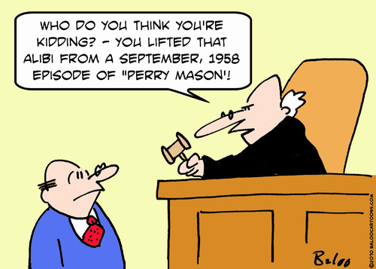
Matching Game Picture A

Slide 23
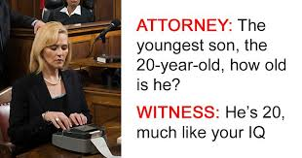
Matching Game Picture B

Slide 24
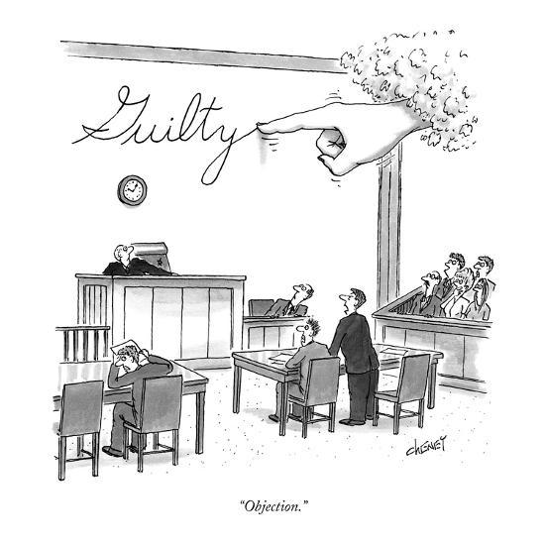
Matching Game Picture C

Slide 25
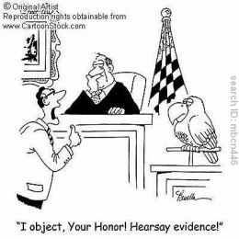
Matching Game Picture D

Slide 26
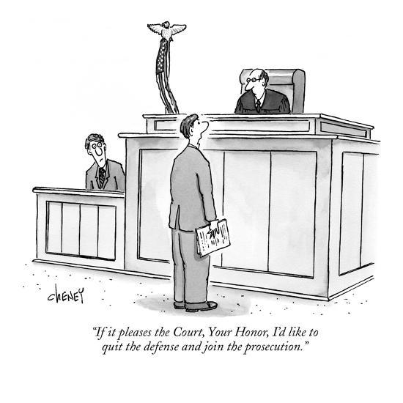
Matching Game Picture E

Slide 27
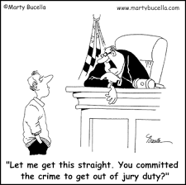
Matching Game Picture F

Slide 28
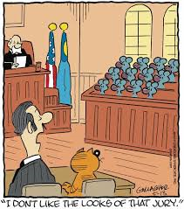
Matching Game Picture G

Slide 29
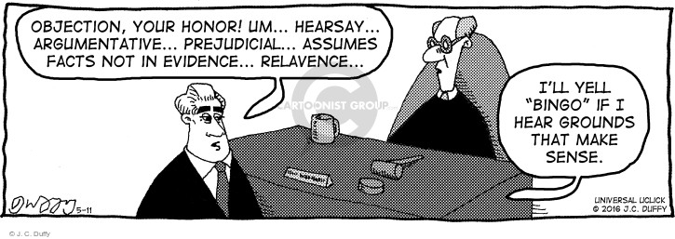
Matching Game Picture H

Slide 30
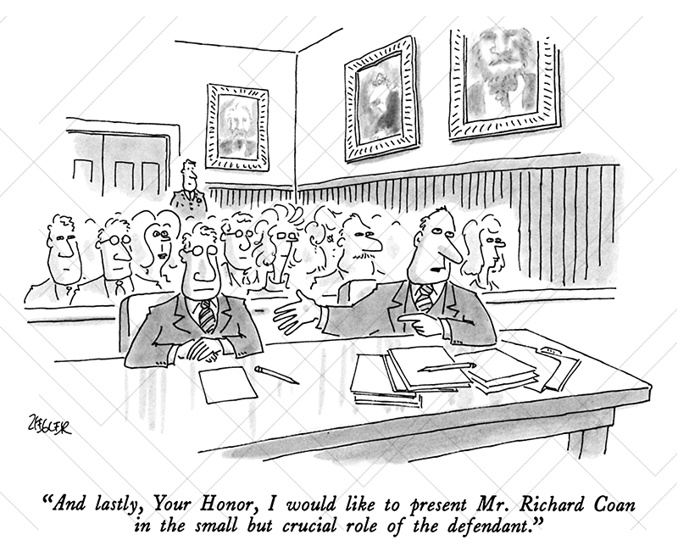
Matching Game Picture I
Notes:
The Prosecutor’s role? Producer, Director, Actor/Actress, Stage hand, Technician,

Slide 31
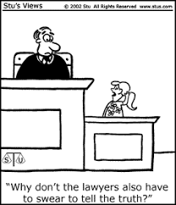
Matching Game Picture J

Slide 32
Lessons Learned
Share Experiences

Slide 33
Lessons Learned
Laying A
Foundation

Slide 34
Lessons Learned
Hearsay

Slide 35
Lessons Learned
Cross- Examination

Slide 36
Lessons Learned
Experts

Slide 37
Lessons Learned
Impermissible
Opening Statement

Slide 38
Lessons Learned
Jury Instructions

Slide 39
Lessons Learned
Impermissible
Closing Argument

Slide 40
Lessons Learned
Mistrial

